Slide 1

Project on Analysis
By Himangshu Rana

Slide 2
Acknowledgement
I would like to express my heartfelt gratitude to my guide, Khusbu Thakur, for her unwavering support and guidance throughout this project. Her insightful feedback and encouragement inspired me to achieve my goals. I truly appreciate her dedication and commitment, which played a pivotal role in the successful completion of this presentation. Thank you, Ma`am !

Slide 3
Introduction
Nitin is a graphic designer with a monthly income of Rs 15,000. He wants to buy a scooter for daily commutes. Currently, he hasn't been able to save due to expenses. I will analyze his financial data to identify areas for improvement and create a plan to achieve his financial goals.

Slide 4
Nitin's Scooter Savings Plan
This project analyzes Nitin's financial situation, aiming to create a plan to help him save for a scooter. I will explore his income, expenses, and create a personalized savings plan. This presentation will use data visualization to make the information easy to understand and provide actionable recommendations.
1
Income
2
Goal
3
Problem
Rs 15,000 per month.
Scooter purchase.
No savings.

Slide 5
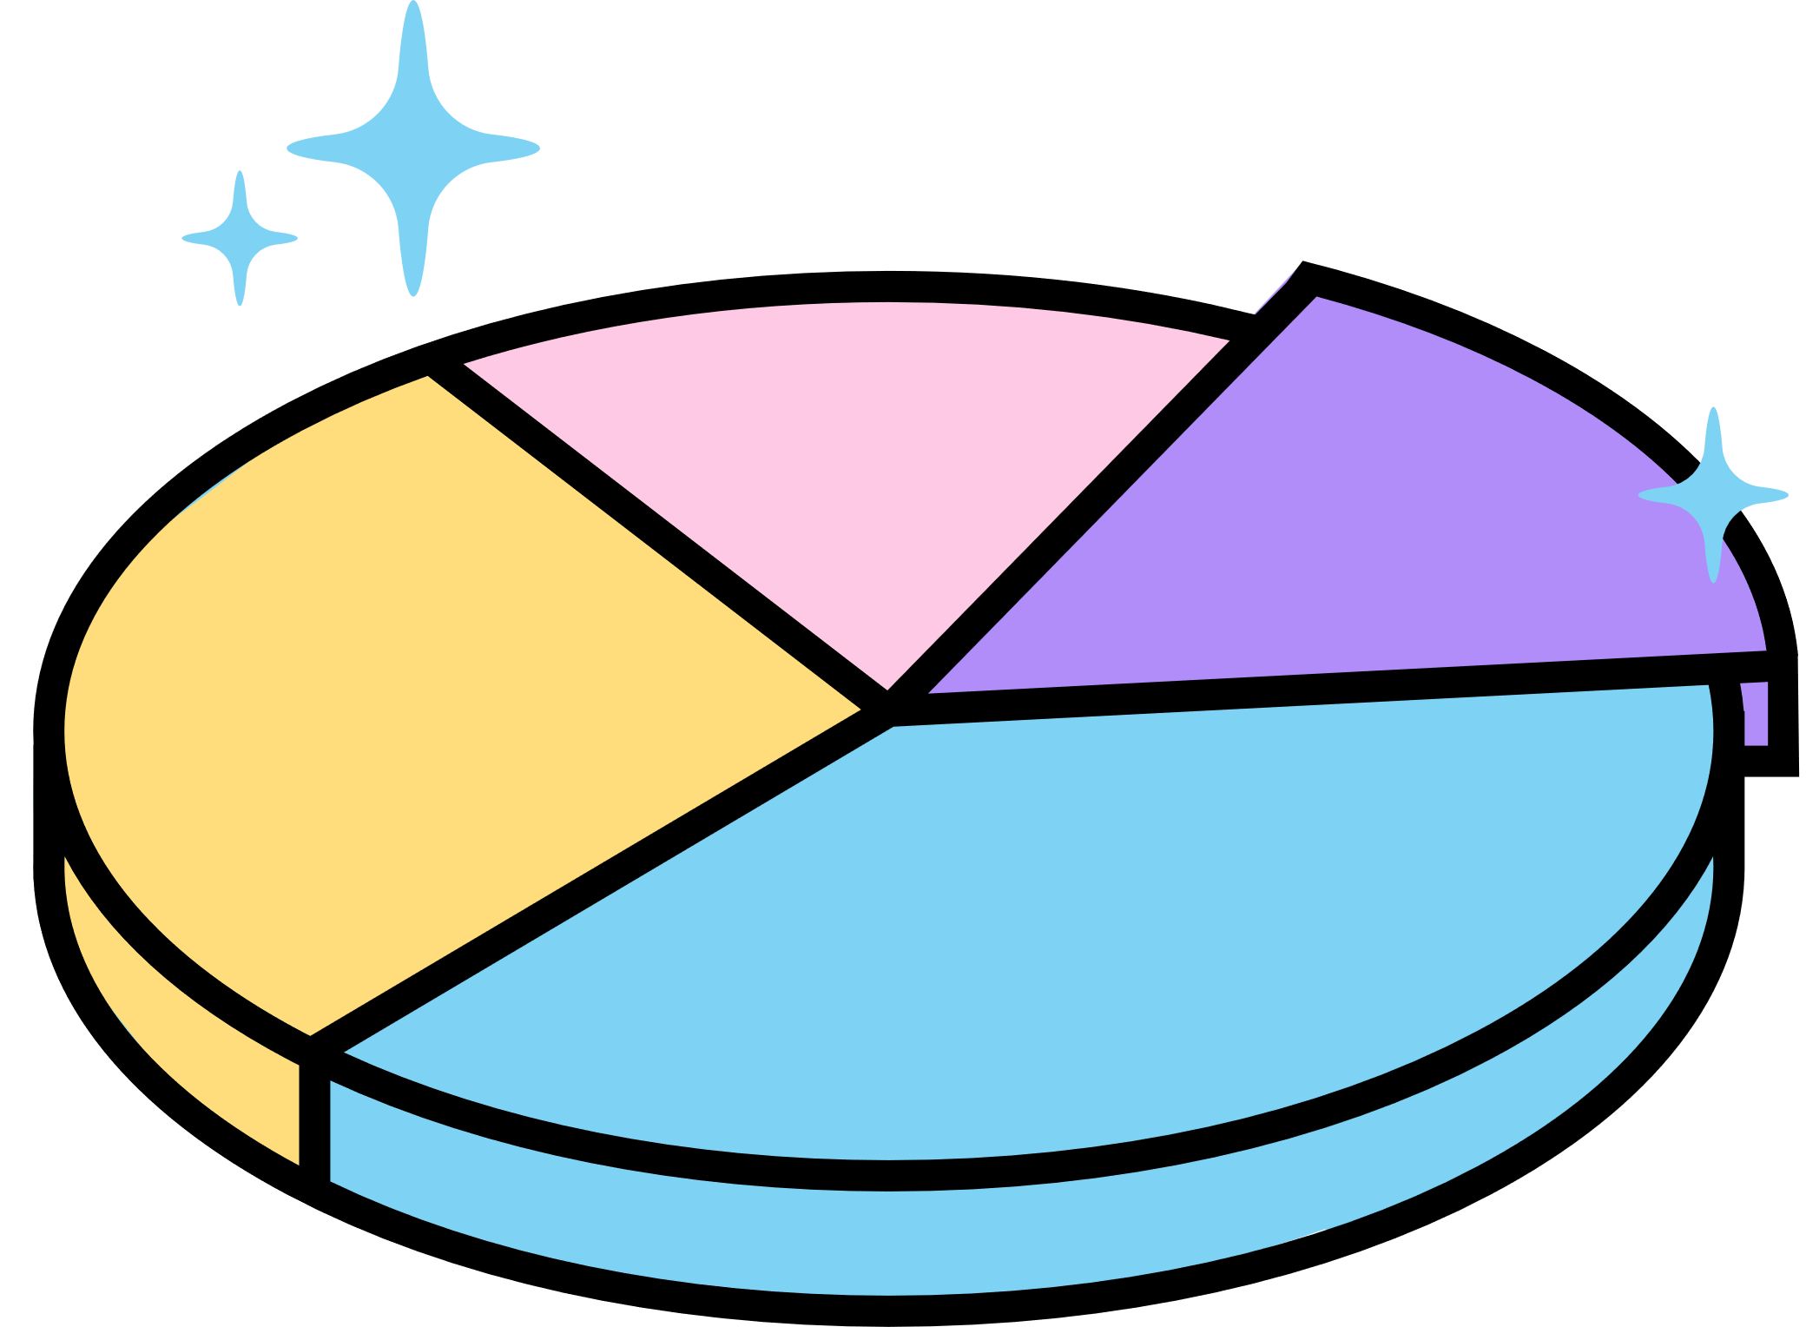

Project: Part I
Analyse the data for the month of June

Slide 6
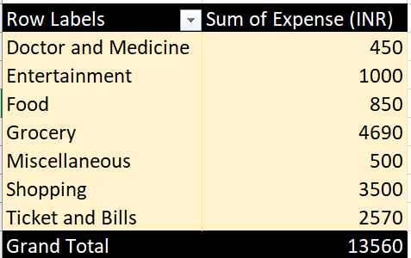
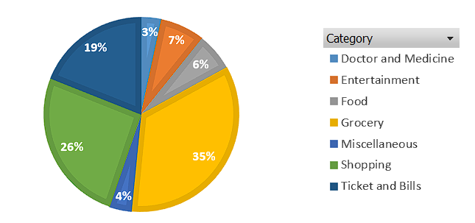
How much is spent for each category

Slide 7
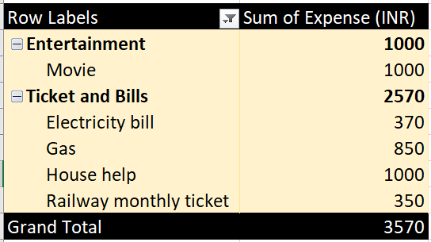
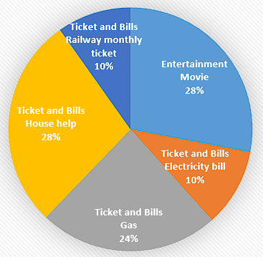
How much the amount spent on different items of Entertainment and Tickets and bills category

Slide 8
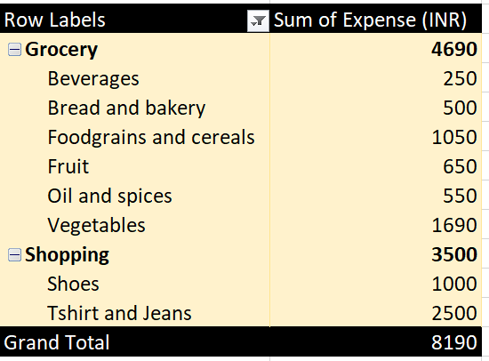
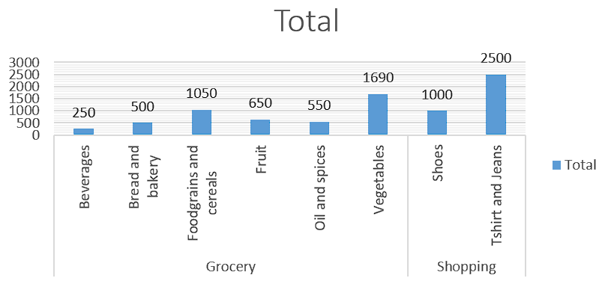
highest and 2nd highest expense amount on this categories

Slide 9
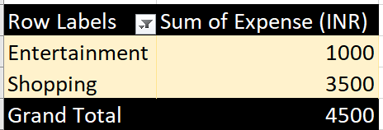
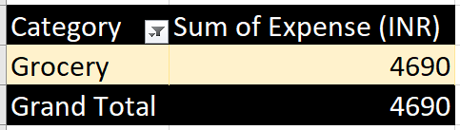
Category with the highest expense amount
Total expense amount against entertainment and shopping

Slide 10
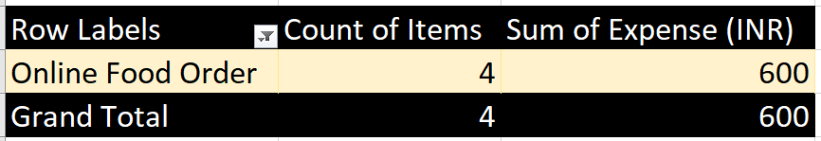
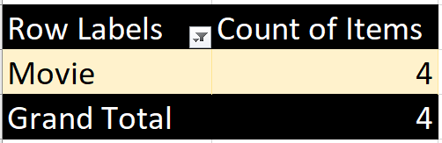
Number of times Nitin has ordered food online and the amount spent on it
Number of times Nitin has watched a movie

Slide 11
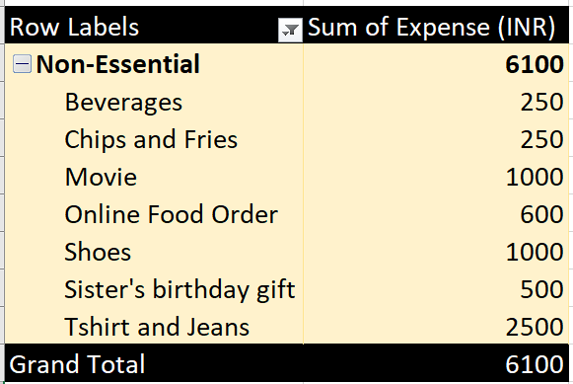
The less essential category that Nitin may remove to increase his savings

Slide 12

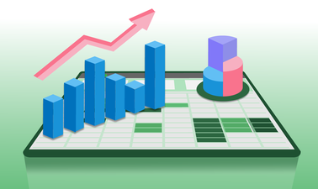
Project: Part II
Analyse the data for the Last 6 month

Slide 13
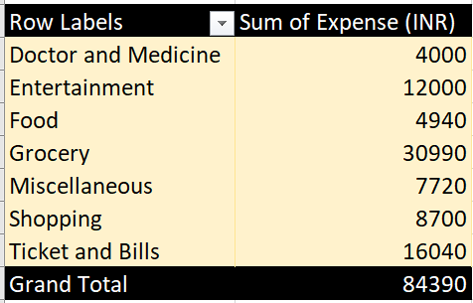
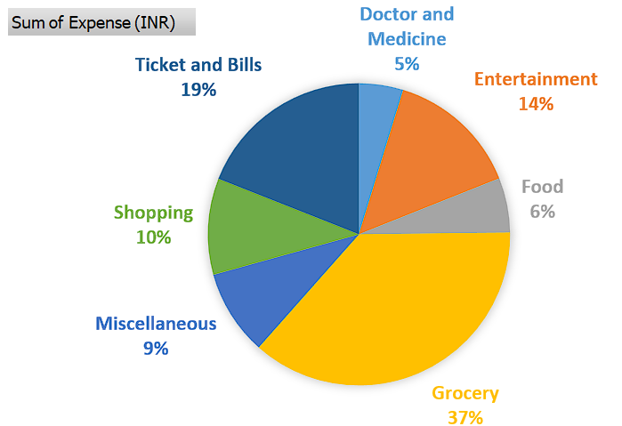
How much is spent for each category

Slide 14
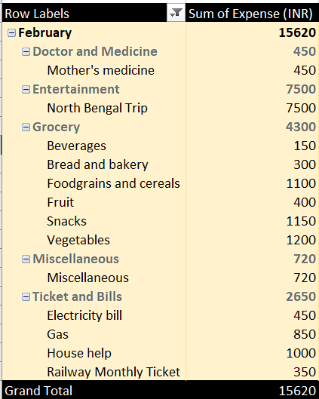
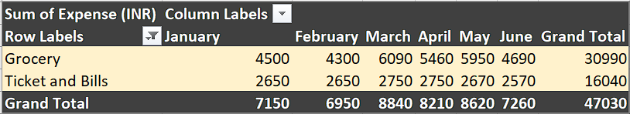
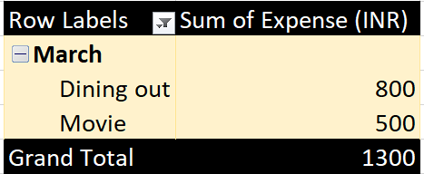
The month Nitin spent the most
Top 2 categories with higher expenses for each month
The month, highest amount spent for movies and dining out

Slide 15
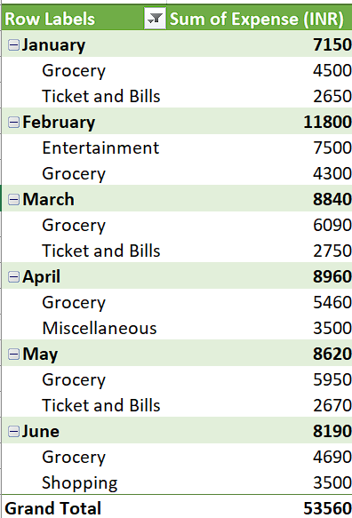
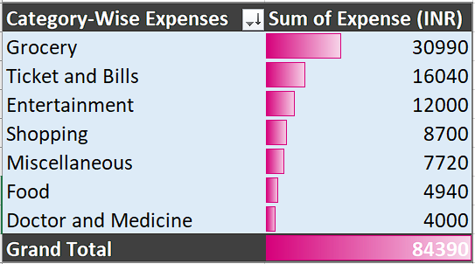
Top 2 categories with higher expenses for each of the 6 months
Data Bars to display categories with the highest to lowest expense amount

Slide 16
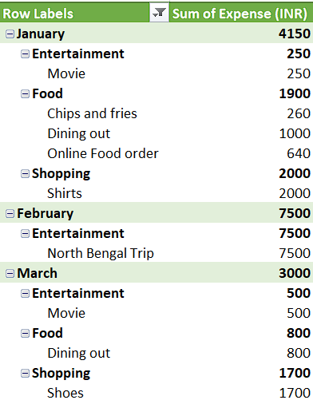
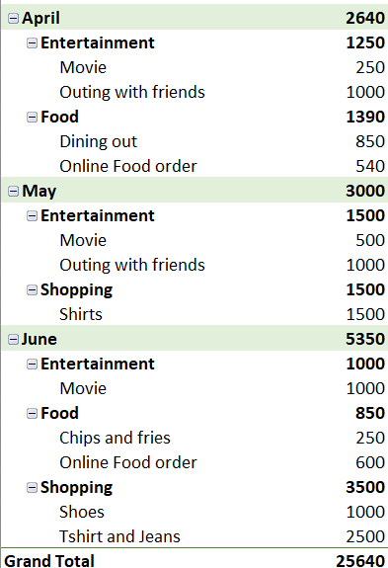
How much spent on each month against different items of Entertainment, Food and Shopping categories

Slide 17
Recommendations
Food Expenses
Dining Out: Reduce costs by:
Meal Planning: Cook at home.
Limit Dining Out: Set a monthly budget.
Use Discounts: Seek deals and coupons.
Grocery Expenses
Grocery Shopping: Reduce bills by:
Create a Shopping List: Avoid impulse buys.
Buy in Bulk: Save on non-perishable items.
Seasonal Produce: Buy fruits and vegetables in season.
Reduce Snacks: Limit snack purchases.

Slide 18
Entertainment Expenses
Movies and Outings: Manage costs by:
Limit Expenses: Set a monthly entertainment budget.
Use Subscriptions Wisely: Cancel unused streaming services.
Free Activities: Attend free events and community activities.
Ticket and Bills
Utilities and Transport: Cut costs by:
Energy Efficiency: Practice energy-saving habits at home.
Public Transport: Use public transit to save on gas.
Shopping Expenses
Clothing: Save on clothing by:
Seasonal Sales: Shop during sales or off-peak times.
Wardrobe Audit: Review existing clothes to avoid unnecessary purchases.

Slide 19
Thank You

